Slide 1
Swin Transformer: Hierarchical Visiosn Transformer using Shifted Window
IEEE/CVF International Conference on Computer Vision (ICCV)2021
Ze Liu, Yutong Lin, Yue Cao, Han Hu, Yixuan Wei, Zheng Zhang, Stephen Lin, Baining Guo, Microsoft Research Asia University of Science and Technology of China, Xian Jiaotong University, Tsinghua University
Date : 2026/3/4 Presenter : Yi-Cheng Wang (王翊丞) Advisor : Prof. Jim-Wei Wu (吳俊緯)

Slide 2
Summary
Main Contributions of Swin Transformer
Hierarchical Architecture: Introduced Patch Merging to construct a multi-scale feature pyramid, solving the fixed-scale limitation of traditional Vision Transformers.
Shifted Window Attention (SW-MSA): Achieved linear computational complexity by restricting self-attention to local windows, while enabling cross-window communication through a shifting mechanism.
General-Purpose Vision Backbone: Demonstrated state-of-the-art (SOTA) performance across diverse vision tasks, including image classification, object detection, and semantic segmentation, proving Transformers can effectively replace CNN backbones.

Slide 3
Outline
Introduction
Related Work
Method
Experiment
Conclusion

Slide 4
I. Introduction
Computer vision has long been dominated by Convolutional Neural Networks (CNNs), which have evolved from AlexNet[35] to become increasingly powerful through greater scale and connectivity.
In contrast, Natural Language Processing (NLP) has adopted the Transformer architecture, utilizing attention mechanisms to model long-range dependencies. Inspired by the success of Transformers in the language domain, researchers are now actively investigating their adaptation to computer vision, where they have demonstrated promising results in tasks such as image classification[19].
[19] Alexey Dosovitskiy, Lucas Beyer, Alexander Kolesnikov, Dirk Weissenborn, Xiaohua Zhai, Thomas Unterthiner, Mostafa Dehghani, Matthias Minderer, Georg Heigold, Sylvain Gelly, Jakob Uszkoreit, and Neil Houlsby. An image is worth 16x16 words: Transformers for image recognition at scale. In International Conference on Learning Representations, 2021.
[35] Alex Krizhevsky, Ilya Sutskever, and Geoffrey E Hinton. Imagenet classification with deep convolutional neural networks. In Advances in neural information processing systems, pages 1097–1105, 2012.

Slide 5
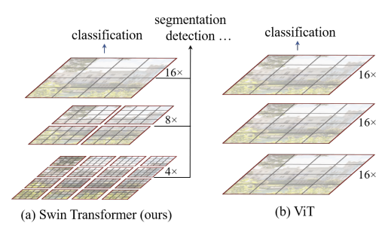
I. Introduction
In existing Transformer-based models [58, 19], tokens are all of a fixed scale, a property unsuitable for these vision applications. Another difference is the much higher resolution of pixels in images compared to words in passages of text. There exist many vision tasks such as semantic segmentation that require dense prediction at the pixel level, and this would be intractable for Transformer on high-resolution images, as the computational complexity of its self-attention is quadratic to image size.
To overcome these issues, this paper proposed a general-purpose Transformer backbone, called Swin Transformer, which constructs hierarchical feature maps and has linear computational complexity to image size.
[19] Alexey Dosovitskiy, Lucas Beyer, Alexander Kolesnikov, Dirk Weissenborn, Xiaohua Zhai, Thomas Unterthiner, Mostafa Dehghani, Matthias Minderer, Georg Heigold, Sylvain Gelly, Jakob Uszkoreit, and Neil Houlsby. An image is worth 16x16 words: Transformers for image recognition at scale. In International Conference on Learning Representations, 2021.
[58] Ashish Vaswani, Noam Shazeer, Niki Parmar, Jakob Uszkoreit, Llion Jones, Aidan N Gomez, Łukasz Kaiser, and Illia Polosukhin. Attention is all you need. In Advances in Neural Information Processing Systems, pages 5998–6008, 2017.
Notes:
以前的 ViT 模型，從頭到尾都維持著單一的解析度（例如永遠都是 16x 下採樣）。 -> 在真實世界的圖片裡，物體的大小差異極大（多尺度）。一台近處的車可能很大，遠處的行人可能只剩幾個像素。如果模型永遠只能用同一種「固定大小的網格」去看世界，它就無法同時處理巨大和微小的物體。
之前的Vision Transformer中是一開始就直接下取樣16倍，後面的特徵圖也是維持這個下取樣率不變

Slide 6
Outline
Introduction
Related Work
Method
Experiment
Conclusion

Slide 7
II. Related Work
CNN and variants While Convolutional Neural Networks (CNNs) have long served as the standard backbone in computer vision through evolving architectures like AlexNet and ResNet, recent studies highlight the strong potential of Transformer-like architectures as general-purpose backbones.
Self-attention based backbone architectures Inspired by the success of Transformers in NLP, prior works attempted to replace spatial convolutions in architectures with local self-attention layers (Sliding Window). Although these methods achieved slightly better accuracy-FLOPs trade-offs, their costly memory access resulted in significantly higher latency compared to convolutional networks. To address this bottleneck, this paper propose a shifted window strategy to replace sliding windows, which allowing for a much more efficient implementation on general hardware.
Notes:
過去十年來，卷積神經網路 (CNN) 一直是視覺任務的標準配備。從早期的 AlexNet 到廣泛應用的 ResNet，CNN 憑藉著優異的局部特徵萃取能力，確立了它作為標準骨幹網路 (Backbone) 的地位。然而，隨著自然語言處理領域的技術跨界，近期的研究強烈顯示：基於自注意力機制 (Self-attention) 的 Transformer 架構，同樣具備成為『通用視覺骨幹網路』的強大潛力。而這篇 Swin Transformer 論文的核心貢獻，正是為了解決 Transformer 在視覺任務上的硬體運算瓶頸，正式挑戰 CNN 長期以來的霸主地位。」
雖然先前的研究嘗試以局部自注意力機制取代傳統卷積，並取得了不錯的理論運算量與準確率折衷（Accuracy-FLOPs trade-offs）。但是，他們採用的『滑動視窗（Sliding Window）』設計，在底層硬體上會引發極高昂的記憶體存取成本，導致實際推論的延遲（Latency）遠高於傳統的卷積神經網路。

Slide 8
II. Related Work
Self-attention/Transformers to complment CNNs Another line of research augments standard CNN architectures with self-attention layers or utilizes Transformers within detection heads[29, 24] to model distant dependencies. Unlike these hybrid methods, this paper explores adapting Transformers for basic visual feature extraction, making Swin Transformer complementary to these existing works.
Transformer based vision backbones While the Vision Transformer (ViT)[19] and DeiT[57] demonstrated the efficacy of Transformers for image classification, their utility as general-purpose backbones for dense vision tasks is hindered by low-resolution feature maps and quadratic computational complexity. Conversely, the Swin Transformer addresses these limitations by constructing hierarchical feature maps with linear complexity through local operations, thereby achieving state-of-the-art performance on benchmarks such as COCO object detection and ADE20K semantic segmentation.
[24] Jiayuan Gu, Han Hu, Liwei Wang, Yichen Wei, and Jifeng Dai. Learning region features for object detection. In Proceedings of the European Conference on Computer Vision (ECCV), 2018
[29] Han Hu, Jiayuan Gu, Zheng Zhang, Jifeng Dai, and Yichen Wei. Relation networks for object detection. In Proceedings of the IEEE Conference on Computer Vision and Pattern Recognition, pages 3588–3597, 2018..
Notes:
當時有許多研究（例如 DETR），是保留傳統 CNN 作為底層的特徵萃取器，並將 Transformer 放置在網路的末端（如預測頭），專門用來處理物件之間的全局關聯性。
然而，本篇論文的 Swin Transformer 走的是完全不同的路線。作者的目標，是讓 Transformer 直接執行『最基礎的視覺特徵擷取』，也就是徹底取代 CNN 作為 Backbone（骨幹網路）的角色。
雖然先前的 ViT 與 DeiT 證明了 Transformer 在『影像分類』上的可行性，但當面對需要精準標記每一個像素的『密集視覺任務（如物件偵測與分割）』時，它們卻因為缺乏高解析度特徵圖，以及具有平方級別 ($O(N^2)$) 的龐大運算複雜度，而無法成為通用的骨幹網路。
相對地，本篇論文提出的 Swin Transformer，透過局部視窗操作，成功將計算複雜度大幅降低至線性級別 ($O(N)$)，並建構了階層式的特徵圖。這不僅徹底解決了前代 Transformer 的硬體瓶頸，更證明了它是真正能勝任所有下游視覺任務的通用架構，而我們前面看到的 COCO 與 ADE20K 歷史最高分，正是這個架構優勢的具體展現。」

Slide 9
Outline
Introduction
Related Work
Method
Experiment
Conclusion

Slide 10
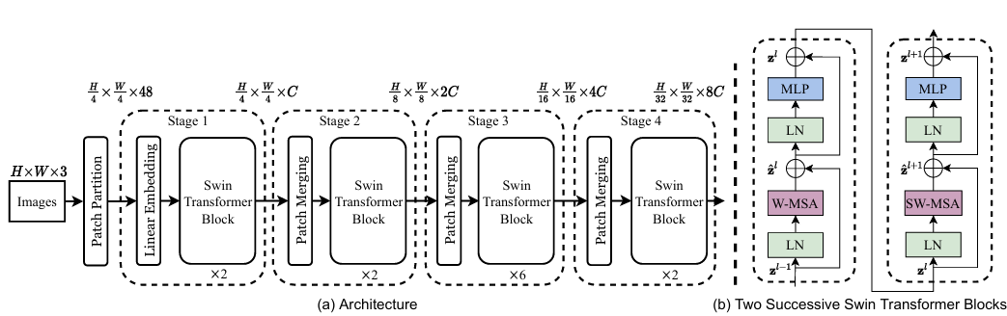
III. Method
Overall Architecture An overview of the Swin Transformer architecture is presented in Figure 2, which illustrates the tiny version (Swin T). It first splits an input RGB image into non-overlapping patches by a patch splitting module, like ViT. In the implementation, this paper uses a patch size of 4×4 and thus the feature dimension of each patch is 4 × 4 × 3 = 48. A linear embedding layer is applied on this raw-valued feature to project it to an arbitrary dimension (denoted as C).
Figure 2. The architecture of a Swin Transformer (Swin-T)
Notes:
首先將一張圖片按給定大小分成一堆 Patches，將輸入圖片 [H, W, 3] 按照 4x4 大小的 Patch 進行劃分，劃分後會得到 [H/4, W/4, 48] 個 Patches。因為每個 Patches 裡有 4x4=16 個像素，然後每個像素有 R、G、B 三個值所以展平後是 16x3=48。接著通過 Embedding 層將每個 Patch 的 Channel 數據做線性映射，由 48 變成 C。這樣每個 Patche 數據 Shape 從 [H/4, W/4, 48] 變為 [H/4, W/4, C] 。Source Code 中 Patch Partition 和 Linear Embeding 就是直接通過一個卷積層實現的，和之前 Vision-Transformer 中講的 Embedding 層結構一模一樣。

Slide 11
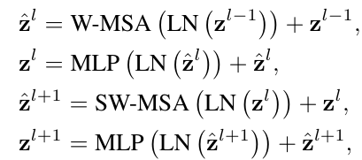
III. Method
Swin Transformer block Swin Transformer is built by replacing the standard multi-head self attention (MSA) module in a Transformer block by a module based on shifted windows.
As illustrated in Figure 3, a Swin Transformer block consists of a shifted window based MSA module, followed by a 2-layer MLP. A LayerNorm (LN) layer is applied before each MSA module and each MLP, and a residual connection is applied after each module.
Figure 3. Two Successive Swin Transformer Blocks
Notes:
難題一：全局計算太慢 靠 W-MSA 解決
如果像傳統 ViT 那樣讓整張圖的所有 Patch 互相算 Attention，運算量會跟圖片大小呈平方級別暴增。圖片稍微大一點，顯示卡就直接燒掉（Out of Memory）。
W-MSA 的好處：把計算嚴格限制在局部的 Window 裡，運算量瞬間降為線性級別。這保證了模型可以處理高解析度的圖片。
難題二：視窗之間無法溝通 靠 SW-MSA 解決
W-MSA 雖然快，但會造成**「楚河漢界」**的效應。每個 Window 都在閉門造車，左邊的 Window 永遠不知道右邊的 Window 發生了什麼事。這對於需要看懂大範圍物件（例如橫跨兩個 Window 的一台車）是致命傷。
SW-MSA 的好處：透過「平移視窗」，它巧妙地打破了上一層的邊界！它讓原本屬於不同 Window 的邊緣 Patch，在下一層能夠互相交流資訊。
Residual Connection 目的是保留原始輸入信息，因為當我們在一個神經網絡中進行多個層的運算時，有時候我們擔心模型可能會丟失原始輸入的重要信息，通過將前一層的輸出與當前層的輸入相加，確保了原始輸入信息的傳遞。
防止「梯度消失」 (Vanishing Gradient)：當網路疊到幾十層、甚至上百層時，數學上的梯度（也就是更新模型的訊號）在回傳時會越乘越小，最後導致前面的層學不到東西。
Layer Normalization 用於正規化每一層的輸出，以確保模型在訓練過程中更穩定，提高訓練的穩定性，有助於模型更快地收斂到最優解。

Slide 12
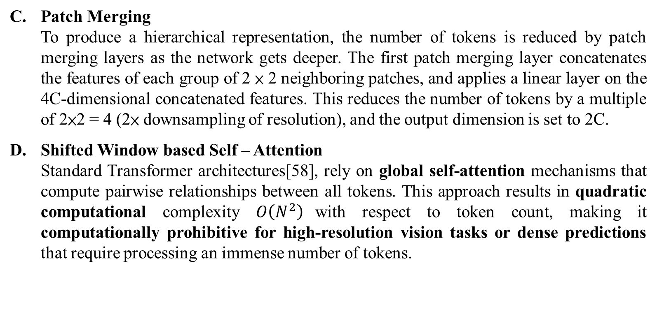
III. Method
Patch Merging To produce a hierarchical representation, the number of tokens is reduced by patch merging layers as the network gets deeper. The first patch merging layer concatenates the features of each group of 2 × 2 neighboring patches, and applies a linear layer on the 4C-dimensional concatenated features. This reduces the number of tokens by a multiple of 2×2 = 4 (2× downsampling of resolution), and the output dimension is set to 2C.
Shifted Window based Self – Attention Standard Transformer architectures[58], rely on global self-attention mechanisms that compute pairwise relationships between all tokens. This approach results in quadratic computational complexity $O\left(N^{2}\right)$with respect to token count, making it computationally prohibitive for high-resolution vision tasks or dense predictions that require processing an immense number of tokens.
[58] Ashish Vaswani, Noam Shazeer, Niki Parmar, Jakob Uszkoreit, Llion Jones, Aidan N Gomez, Łukasz Kaiser, and Illia Polosukhin. Attention is all you need. In Advances in Neural Information Processing Systems, pages 5998–6008, 2017.

Slide 13
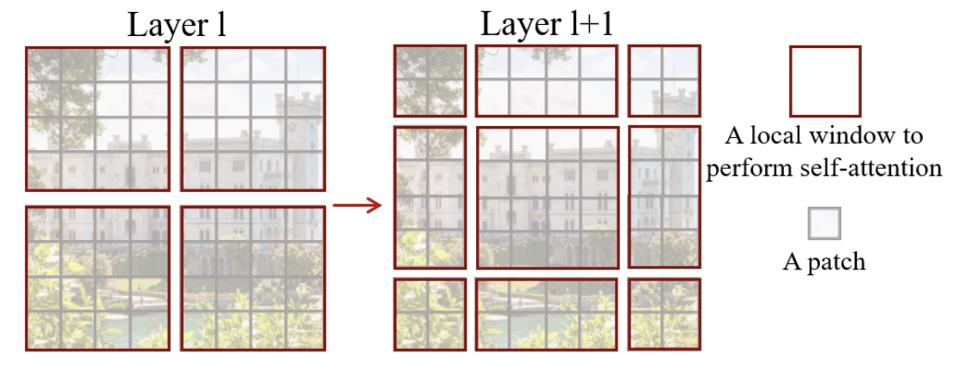
III. Method
Shifted window partitioning in successive blocks The window-based self-attention module lacks connections across windows, which limits its modeling power. To introduce cross-window connections while maintaining the efficient computation of non-overlapping windows, we propose a shifted window partitioning approach which alternates between two partitioning configurations in consecutive Swin Transformer blocks.
Figure 5. An illustration of the shifted windows approach for computing self-attention in the proposed Swin Transformer architecture.

Slide 14
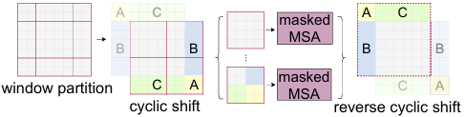

III. Method
Efficient batch computation for shifted configuration To address the computational overhead caused by the increased number of windows in shifted partitioning (e.g., from $2 ×2$to $3 ×3$), the Swin Transformer employs an efficient cyclic-shift strategy.
Instead of using zero-padding which increases computation, the feature map is cyclically shifted toward the top-left direction to reassemble fragmented edge windows into a standard grid, maintaining the same number of windows as regular partitioning.
Figure 4. Illustration of an efficient batch computation approach for self-attention in shifted window partitioning.

Slide 15
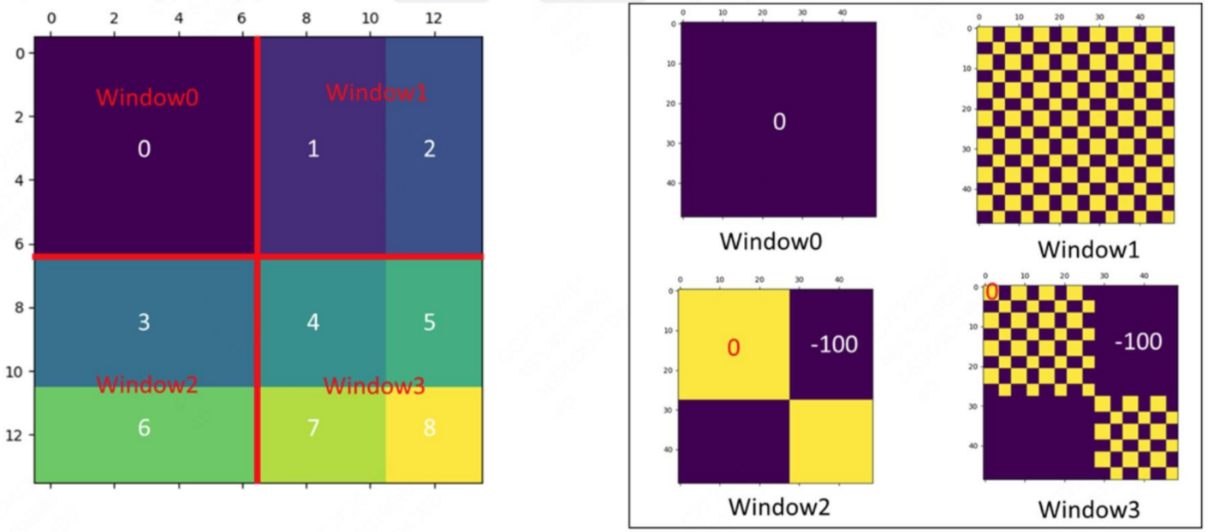
III. Method

Slide 16
III. Method
Architecture Variants The Authors build their base model, called Swin-B, to have of model size and computation complexity similar to ViT B/DeiT-B. They also introduce Swin-T, Swin-S and Swin-L, the architecture hyper-parameters of these model variants are:
• Swin-T: C = 96, layer numbers = {2,2,6,2}
• Swin-S: C = 96, layer numbers ={2,2,18,2}
• Swin-B: C = 128, layer numbers ={2,2,18,2}
• Swin-L: C = 192, layer numbers ={2,2,18,2}

Slide 17
Outline
Introduction
Related Work
Method
Experiment
Conclusion

Slide 18
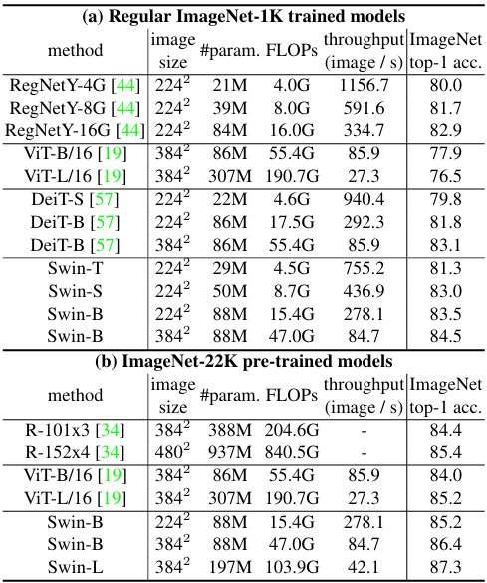
IV. Experiment
Image Classification with Regular ImageNet-1K training
Surpasses SOTA Transformers: Noticeably outperforms DeiT with similar complexity, achieving +1.5% accuracy gain for Swin-T (81.3%) and Swin-B (83.5%).
Better Trade-off: Achieves a slightly better speed-accuracy trade-off than state-of-the-art ConvNets (RegNet). Noting that while RegNet [44] are obtained via a thorough architecture search.
Table1. (a) Comparisons to other backbones, including both Transformer-based and ConvNet-based, using regular ImageNet-1K training.
[44] Ilija Radosavovic, Raj Prateek Kosaraju, Ross Girshick, Kaiming He, and Piotr Doll´ar. Designing network design spaces. In Proceedings of the IEEE/CVF Conference on Computer Vision and Pattern Recognition, pages 10428 10436, 2020.
Notes:
ImageNet-1k : 1.28 million training images and 50,000 validation images
/16 -> patch size = 16 x 16
缺點:
RegNetY-4G (傳統 CNN)：理論運算量 FLOPs 是 4.0G，實際每秒能跑 1156.7 張圖片。
Swin-T (Transformer)：理論運算量 FLOPs 是 4.5G，實際每秒只能跑 755.2 張圖片。
雖然 Swin Transformer 在數學紙本上（FLOPs）把運算量壓得很低，看似跟 CNN 一樣輕量；但在真實硬體運作時，因為它需要頻繁搬動記憶體（切視窗與平移），導致它實際的處理速度（Throughput）還是明顯輸給了高度優化的 CNN。
throughput (執行速度)
意思是：真實速度（一秒鐘能處理幾張圖）。
單位：image/s (images per second)。
影響：
這是最現實的指標。FLOPs 只是理論值，Throughput 才是你跑起來的感覺。
數字越大越好（跑得越快）。
例如：Swin-T 一秒能跑 755.2 張圖，超快；Swin-B (384) 一秒只能跑 84.7 張。

Slide 19
IV. Experiment
Image Classification with ImageNet-22K pre-training
Significant Gains from Pre-training: Pre-training on ImageNet-22K boosts Swin-B accuracy by 1.8%~1.9% compared to training from scratch.
Superior Trade-off vs. ViT: Swin-B achieves 86.4% top-1 accuracy, surpassing ViT-B (84.0%) by +2.4% with slightly lower FLOPs and similar throughput. (47.0G vs. 55.4G)
State-of-the-Art Performance: The larger Swin-L model achieves an impressive 87.3% top-1 accuracy.
Table1. (b) Pre-train the larger-capacity Swin-B and Swin-L on ImageNet-22K Results fine-tuned on ImageNet-1K image classification.
Notes:
ImageNet-22K 裡面大約有「1400 萬張」圖片
R-101：代表擁有 101 層。
R-152：代表擁有 152 層。
x3：代表將每一層的通道數強制放大 3 倍。
x4：代表將每一層的通道數強制放大 4 倍。
throughput (執行速度)
意思是：真實速度（一秒鐘能處理幾張圖）。
單位：image/s (images per second)。
影響：
這是最現實的指標。FLOPs 只是理論值，Throughput 才是你跑起來的感覺。
數字越大越好（跑得越快）。
例如：Swin-T 一秒能跑 755.2 張圖，超快；Swin-B (384) 一秒只能跑 84.7 張。

Slide 20
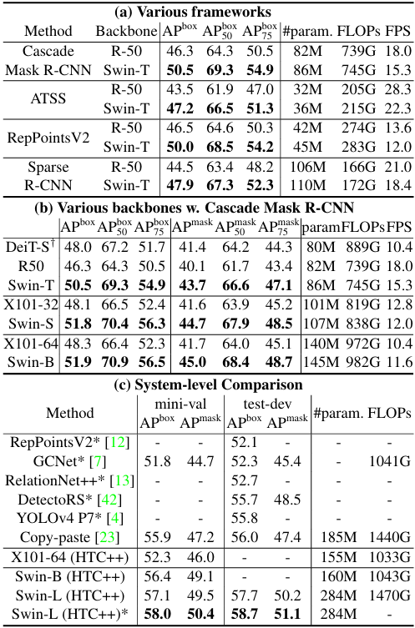
IV. Experiment
Object Detection on COCO
Table2(a) lists the results of Swin-T and ResNet-50 on the four different object detection frameworks. Swin-T architecture brings consistent+3.4∼4.2 box AP gains over ResNet-50,with slightly larger model size, FLOPs and latency.
Table2(b) lists the results of Under the same framework, Swin-T and Swin-B outperform ResNet-50 and ResNeXt-101 by +4.2 and +3.6 AP respectively, while Swin-T beats DeiT-S by +2.5 AP.
AP (Average Precision): Measuring how accurately the model detects objects.
AP50 / AP75 Accuracy: Scores based on strictness
AP Mask: The accuracy score for instance segmentation.
Table2.Results on COCO object detection and instance segmentation.
Notes:
What is Cascade? (in Cascade R-CNN)
Concept: A multi-stage architecture that sequentially refines detection results.
† denotes that additional decovolution layers are used to produce hierarchical feature maps.

Slide 21
IV. Experiment
Object Detection on COCO
Comparison to previous state-of-the-art The best model achieves a new State-of-the-Art (SOTA) on COCO test-dev with 58.7 box AP and 51.1 mask AP, outperforming the previous best result by +2.7 box AP and + 2.6 mask AP.
Table2.Results on COCO object detection and instance segmentation.
Notes:
test-dev：這是 COCO 資料集裡最嚴格的測試集。它的標準答案是不公開的，研究人員必須將模型的預測結果上傳到官方伺服器進行評分，無法作弊，因此這裡的數據最具公信力。
box AP = 評估 AI 畫長方形框框畫得準不準的分數。
mask AP = 評估 AI 沿著物體邊緣精準塗色（分割像素）塗得準不準的分數。
在 (物件偵測) 任務上，之前的最高分是由 Google 的 Copy-paste [23] 所創下的 56.0 分 (test-dev 數據)。
在 (實例分割) 任務上，之前的最高分是由 DetectoRS* [42] 創下的 48.5 分 (test-dev 數據)。
標註星號 * 的模型代表啟用了 Multi-scale testing。
這是一種推論階段的增強技術，透過讓模型在多個不同的解析度下重複觀察同一張影像，並融合最終預測結果，來進一步提升對不同尺度物件的偵測穩定性。
雖然這會顯著增加運算成本並降低 FPS
Swin Transformer 本身是一個特徵提取器（Backbone），它的強項在於透過階層式架構產生高品質的特徵表示。然而，要完成物件偵測或分割任務，我們必須將其接入一個偵測框架(HTC++)。

Slide 22
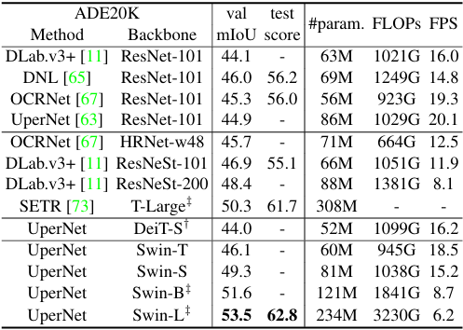
IV. Experiment
Semantic Segmentation on ADE20K
Swin-S significantly outperforms DeiT-S (+5.3 mIoU), ResNet-101 (+4.4 mIoU), and ResNeSt-101 (+2.4 mIoU) under similar computation costs, while the pre-trained Swin-L model achieves a new State-of-the-Art of 53.5 mIoU, beating the previous best SETR model by +3.2 mIoU despite having a smaller model size.
Table3. Results of semantic segmentationon the ADE20K val and testset.
Notes:
UperNet 這個框架的設計，天生就需要吸收「多種不同解析度」的特徵圖
ADE20K 裡面有 150 種又碎又複雜的類別（例如：牆壁、床、枕頭、窗戶）。 UperNet（Unified Perceptual Parsing Network）全名叫做「統一感知解析網路」，它本來就是在學術界公認處理這種「複雜場景解析」最頂尖、最權威的雙手。
† 代表加上額外的反卷積層來產生階層式特徵圖
‡ 代表有在imagenet-22k 預訓練過

Slide 23
Outline
Introduction
Related Work
Method
Experiment
Conclusion

Slide 24
V. Conclusion
This paper presents Swin Transformer, a new vision Transformer which produces a hierarchical feature representation and has linear computational complexity with respect to input image size.
Swin Transformer achieves the state-of-the-art performance on COCO object detection and ADE20K semantic segmentation, significantly surpassing previous best methods.
Author hope that Swin Transformer’s strong performance on various vision problems will encourage unified modeling of vision and language signals

